Slide 1
Price predictions
By: Cesar Contreras

Slide 2
Tucson Arizona
Intelligence assistant for samsung devices like freezers, tv, cell phones, etc ((rival of google home and amazon alexa).
Can be interat by voice, tape, text and pictures.
Direct link to other products and services.

Slide 3
Area of opportunity
The mobiliary industry is one of the most rentable.
The market size reached USD 3.14 Billion in 2021 and is expected to reach USD 39.84 Billion in 2030

Slide 4
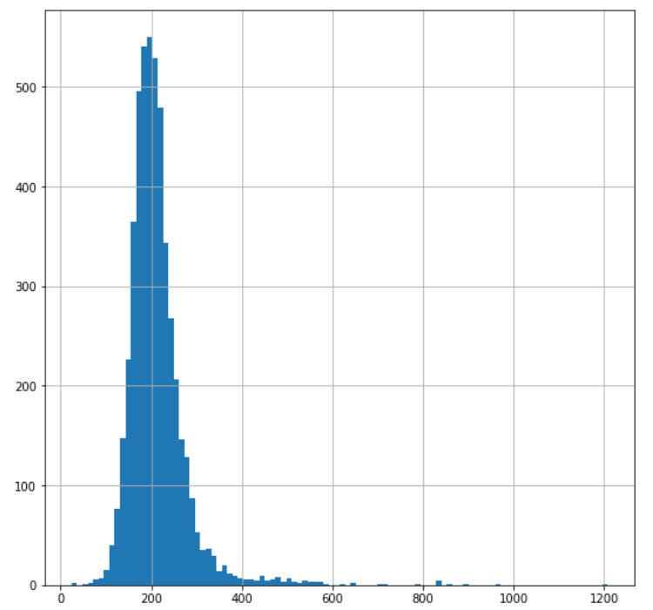
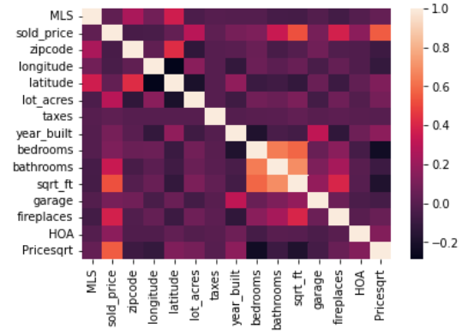
Data exploration
Hist for the distribution of Pricesqrt
Correlation matrix

Slide 5
Before using the models
x >= 0 and x <=150
split data with random at 90-10
KNN
OLS Regression
Haversine

Slide 6
KNN and Linear regression
 | KNN | R2
 | 1 | 0.771
 | 2 | 0.923
 | 3 | 0.938

Slide 7
Link of Github
https://github.com/cesarcontre/KNN-and-OLS

